Slide 1

DevOps For Teams
Principles, Processes, and Practices for Continuous Value Delivery

Slide 2
Purpose
To introduce, demonstrate and hands on exercises of continuous integration, delivery, and DevOps principles, practices and Fannie Mae self-service tools/services.

Slide 3
Content
Workshop Daily Schedule & Cadence
Workshop Day 1 Presentation & Hands-on Exercises
Continuous Integration
Hands-on Exercises
Workshop Day 2 Presentation & Hands-on Exercises
Continuous Delivery
Hands-on Exercises
Workshop Day 3 Presentation & Hands-on Exercises
DevOps
Hands-on Exercises
Appendices
Reference Materials

Slide 4
Overview
Day 1 - Continuous Integration
Culture
Automation
Acceptance Tests - Cucumber
Builds - Maven
Integration servers - Jenkins
Unit tests - Junit
Static analysis – SonarQube, CAST
Day 2 - Continuous Delivery
Process
Organization
Automated deployments – iCart
Data management
Smoke and Integration Testing
Day 3 - DevOps
Measurements
Improvements

Slide 5
Workshop Daily Schedule & Cadence
Agenda | Time | Notes
Breakfast | 8:30-9:00 a.m. | Provided by Fannie Mae
Workshop Start | 9:00-9:15 a.m. | Day 1 – Introductions Day 2 & 3 – Review of previous day’s workshop and discussions
Presentation, Discussion, & Hands-on Exercises | 9:15-12:00 p.m.
Mid-morning Break | 11-11:10 a.m. | Time boxed to 10 minutes
Lunch | 12:00-12:45 a.m.
Presentation, Discussion, & Hands-on Exercises | 12:45-4:15 p.m.
Mid-afternoon Break | 3:00-3:10 p.m. | Time boxed to 10 minutes
End of Day Retrospective | 4:15-4:45 p.m. | Group retrospective on the day’s presentations, discussions, and hands-on exercises
Wrap-up | 4:45-5:00 p.m. | Informal Q&A Informal Discussion
Workshop End | 5:00 p.m.

Slide 6
DevOps For Teams
DevOps Training Workshop – Day 1

Slide 7
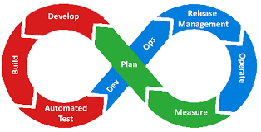
What is DevOps

Slide 8
What is DevOps
Value Statement:
As a devops student
I want to know what devops is
So that I explain, demonstrate and implement DevOps practices and processes
Acceptance Criteria (Gherkin):
Given a team member interested in delivering
When asked what is devops
Then they respond with their understanding of C.A.L.M.S.

Slide 9
What is DevOps? Why
Improving quality is everyone’s job. High-performing organizations spend 22 percent less time on unplanned work and rework.
High performers spend 50 percent less time remediating security issues than low performers.
Employees in high-performing organizations were 2.2 times more likely to recommend their organization to a friend as a great place to work.
High performers deploy 200 times more frequently than low performers, with 2,555 times faster lead times.
Undertaking a technology transformation initiative can produce sizeable cost savings for any organization.
Taking an experimental approach to product development can improve your IT and organizational performance.

Slide 10
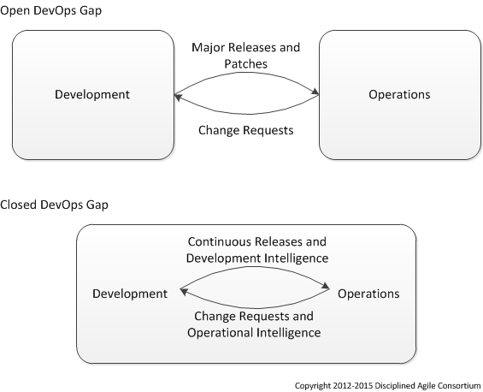
What is DevOps?

Slide 11
What is DevOps?
DevOps is a cultural and professional movement that stresses communication, collaboration and integration between software developers and IT operations professionals.
Responds to accelerated demand for quality software products and services
Acknowledges the interdependence of IT functions
Recognizes the need for cultural improvements
Supports and leverages agile, lean, and IT service management (ITSM) practices
Encourages the use of automation

Slide 12
What is DevOps? Principles
Principles of DevOps
Flow – systems thinking, delivery pipeline
Amplified Feedback Loops– testing and monitoring visual radiators
Continuous Improvement – retrospective, root cause
Small Batches – Iterations, daily check-ins
Minimal Viable Product –
Build Quality In -

Slide 13
What is DevOps? Goals
Goals of DevOps
The goal of the DevOps is to give an application development team the ability to build, test, package, and deploy a fully working system in an automated fashion without involvement from external groups.
Better align IT responsiveness and capabilities to business needs
Produce smaller, more frequent software releases
Reduce effort and risks associated with software development, transition and operation
Improve time to market
Improve quality of code
Improve quality of software deployments
Reduce cost of product iterations and delays
Instill a culture of communication and collaboration
Improve productivity
Improve visibility into IT requirements and processes

Slide 14
What is DevOps? What DevOps is NOT
What DevOps is NOT
A title
A team
A tool
Only culture
Only automation
NoOps
The wild west
“somebody else’s job.”
just creating a Jenkins job that runs and test code.
releasing a WAR file that needs to be deployed somewhere.
having a “Build Person”.

Slide 15
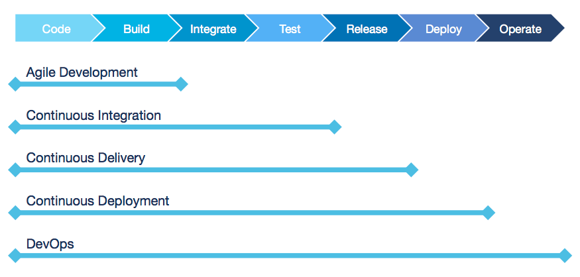
What is DevOps? Evolutions to DevOps

Slide 16
What is DevOps?
If a team does not deploy a working system, then a team has not produced anything.

Slide 17
What is DevOps? Themes
Version control – everything in version controlled, the same repo.
Shift left – move testing earlier in the SDLC or pipeline
Automate everything – if you have done it twice consider automation
Tractability
Repeatability
Reproducibility

Slide 18
















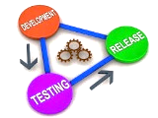





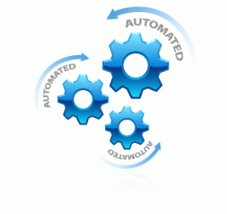






Fannie Mae’s DevOps Tool Chain
DevOps Value Chain
“Transform technology at Fannie Mae for repeatable and scalable software development services that improve quality, reduce costs, and increase time to market”
AUTOMATED TRACEABILITY
iCart
Code
Requirements
Incidents/ Defects
CODE
QUALITY
CONTINUOUS
INTEGRATION/ DELIVERY
Automated Reporting
RELEASE MANAGEMENT
Design
Develop
Discover
Design
Discover
Discover
Test
Deploy
Monitor /
Operate
Test
Test
Design
Design
Sprint #1
Sprint #2
Test
Sprint #3
Develop
Develop
Develop
ENVIRONMENT
CONFIGURATION
TEST DATA DELIVERY
SERVICE VIRTUALIZATION
TEST AUTOMATION
AUTOMATED DATA VALIDATION
90% labor reduction for testing of large unit, component, integration, progression and regression suites
Early identification, tracking and remediation of code defects
Significantly faster provisioning of development & test environments
VM
Delphix
SeleniumHQ
Data Testing
Framework

Slide 19
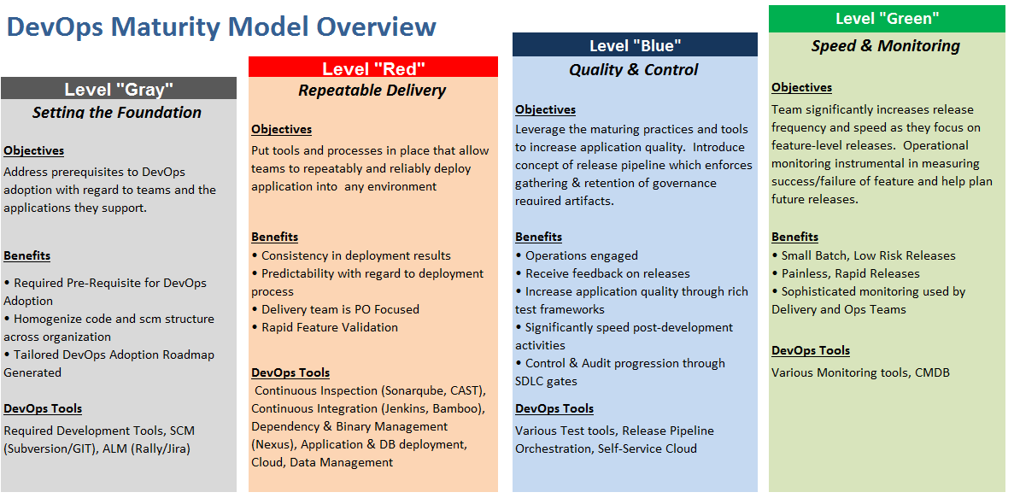
What is DevOps? DevOps Maturity

Slide 20
Culture

Slide 21
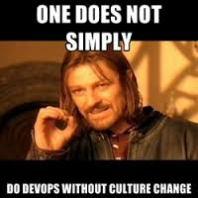
Culture Why
DevOps is the shared responsibility and buy-in of the entire team.

Slide 22
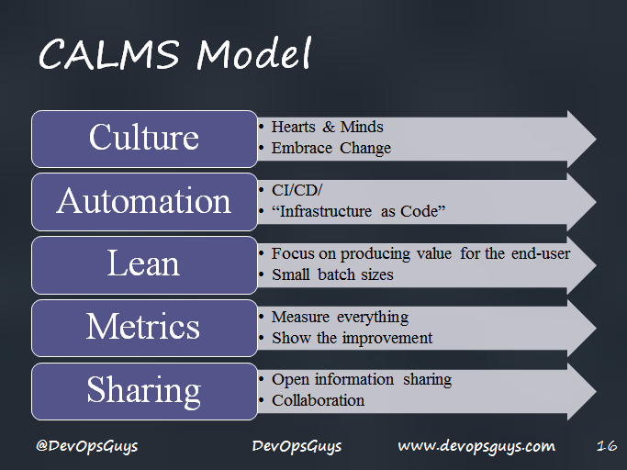
Culture

Slide 23
Culture What
Open Communications
Incentive and responsibility alignment
Respect
Trust
Shared Responsibility
Share information
Focus on customer value
Culture at etsy from velocity - https://vimeo.com/51310058
Creating “One team” culture - https://www.youtube.com/watch?v=ifKUOzPgyHo
Notes:
A DevOps culture is one created through lots of discussion and debate. Traditionally siloed technical teams interact through complex ticketing systems and ritualistic request procedures, which may require director-level intervention.
A DevOps culture is one created through lots of discussion and debate. Traditionally siloed technical teams interact through complex ticketing systems and ritualistic request procedures, which may require director-level intervention.
All team members should respect all the other team members. Respectful discussion and listening to other’s opinions is a learning experience for everyone. No team member should be afraid to speak for fear of being abused or rudely dismissed.
Trust is a massive component of achieving a DevOps culture. Operations must trust that Development is doing what they are because it’s the best plan for the success of the product. Development must trust that QA isn’t really just there to sabotage their successes. The Product Manager trusts that Operations is going to give objective feedback and metrics after the next deployment. If any one part of the team doesn’t trust another part of the team, your tools won’t matter. Additionally, if you don’t trust the people who work for you, why are they working there?

Slide 24
Culture
“Even with the best tools, DevOps is just another buzzword if you don’t have the right culture.”
– Rouan Wilsenach http://martinfowler.com/bliki/DevOpsCulture.html
DevOps is the shared responsibility of an application delivery team and it encompasses the efforts of all members of an application delivery team.
“You might use a particular version control tool and have particular CI server set up, but if you are not checking-in code in small batches frequently, or don’t have automated tests, it’s not really Continuous Integration.”
– Vishal Naik https://www.thoughtworks.com/insights/blog/architecting-continuous-delivery

Slide 25
Culture Next
DevOps is not easy, but it is rewarding.
DevOps requires discipline on the part of the entire team.
The team needs to grow into the DevOps process together.
DevOps requires constant learning and practice.
DevOps can give the team an awesome sense of accomplishment when the team is able to consistently launch a process that results in fully working system.

Slide 26
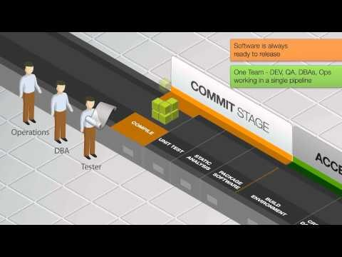
Delivery Pipeline

Slide 27
WIRE Demonstration
WIRE is an application that is part of the CSPi platform. WIRE has several components that are automatically built, tested, and deployed together on each check-in.
After the application is successfully built and tested in the development environment, the code is then deployed to the test environment where it is tested again.
A build fails if any one test fails. The team then works collectively to resolve any failures before moving forward with other work.
WIRE Site:
http://plsysadm-ap58:8080/jenkins/job/wire-site/WIRE_Site/
See “Continuous Delivery” in left navigation
Wire Delivery Pipeline:
http://plsysadm-ap58:8080/jenkins/view/Git-WIRE-Delivery/
Notes:
One of the first project on Enterprise CI/CD
Team immediately embraced a DevOps Culture
Worked with Enterprise CI/CD to improve processes (white boarding, embedding resources within the team)
Still trying to improve – have made great progress, but always room to improve

Slide 28
Discussion Your Team & DevOps
Where does your team currently stand in the transition toward a DevOps culture of shared responsibility?
What challenges has your team faced as you transition towards a DevOps culture?
What are your team’s successes and current pain points with regard to DevOps?

Slide 29
Version Control Systems

Slide 30
Version Control Systems
Value Statement:
As a student
I want to understand version control
So that I can use the power of version to support the development of value for our users.
Acceptance Criteria (Gherkin):
Given a project in version control
When a change is made
Then the whole team and tools have access to that and previous versions
Given a project in version control
When a change is made
Then the whole team and tools have access to that and previous versions

Slide 31
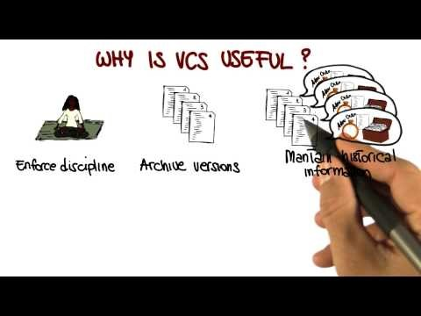
Version Control Systems Why
Repeatability
Tractability
Accountability
Attribution
Baselining
Collaboration
Parallel development
https://www.youtube.com/watch?v=zbKdDsNNOhg

Slide 32
Version Control Systems
A code repository is an absolute necessity for any kind of development effort.
There are multiple flavors or version control systems. For example, Git, Subversion, and ClearCase.
Subversion – a single, centralized repository that hosts all of the branches and tags for a given codebase
Git – a distributed version control system where all the repositories are “equal”; i.e. one on your workstation and one hosted by Fannie Mae’s CI/CD team

Slide 33
Version Control Systems What
A component of software configuration management, version control, also known as revision control or source control, is the management of changes to documents, computer programs, large web sites, and other collections of information.
Changes are usually identified by a number or letter code, termed the "revision number", "revision level", or simply "revision". For example, an initial set of files is "revision 1". When the first change is made, the resulting set is "revision 2", and so on.
Each revision is associated with a timestamp and the person making the change.
Revisions can be compared, restored, and with some types of files, merged.
- Wikipedia

Slide 34
Version Control Systems
Effectively using a version control system
Avoid feature branches as much as possible–the ideal is that the entire team is committing code to trunk as often as possible to fully realize the effectiveness of a CI-build-deploy pipeline.
Create short-lived branches, if necessary, and don’t let them exist for more than a week.
Create a build-test-deploy pipeline for all branches while they are in use.

Slide 35
Version Control Systems How Hands-On Lab
Please follow directions in the site documentation for this module.
Create local branch off of DEV.
Open Git Bash
Navigate (cd) to the user directory
Create and navigate to a new “workshop” directory
Clone Git repository from previous hands-on exercise
Navigate to newly created directory
Create a branch:
git checkout –b feature/us-{f_last}
Any questions or issues? Let us know!

Slide 36
Version Control Systems Next
What do you choose to do with this knowledge and experience?
Will you or your team implement next week/iterations?
Who will you teach it to?
Attend a meetup?
Post what you know on your blog?
References:

Slide 37
Automated Builds

Slide 38
Automated Builds
Value Statement:
As a student
I want to understand
and experience how to automate a software development build
So that we can create reproducible builds on demand
and do continuous integration
Acceptance Criteria (Gherkin):
Given a software project and repository
When issue/enter one command
Then software project/application is compiled, unit tested, static analysis, package and published to the artifact repo

Slide 39
Automated Builds Why
Repeatability
Consistency
Feedback
Fast
Collaboration

Slide 40
Automated Builds What
The "build" in developer parlance consists in the process which, starting from files and other assets under the developers' responsibility, results in a software product in its final or "consumable" form. This may include compiling source files, their packaging into compressed formats (jar, zip, etc.) but also the production of installers, the creation or updating of database schema or data, and so on. The build is "automated" to the extent that these steps are repeatable and require no direct human intervention, and can be performed at any time with no information other than what is stored in the source code control repository.

Slide 41
Automated Builds
In order to ensure DevOps success, it is vital to have an automated build.
Check-in code frequently.
Write one class–even if it’s not fully fleshed out–test it locally, and check it in
Don’t write 20 classes and 40 tests before checking in code
Learn from broken builds.
Be the one to fix the build–embrace shared responsibility
The build will fail, and it is the your job to resolve issues as quickly as possible
It is not okay to have builds failing for days, or even hours

Slide 42
Automated Builds How Hands on Lab
Please follow directions in the site documentation for this module.
In Eclipse, select pom.xml
Any questions or issues? Let us know!

Slide 43
Automated Builds Next
What do you choose to do with this knowledge and experience?
Will you or your team implement next week/iterations?
Who will you teach it to?
Attend a meetup?
Post what you know on your blog?
References:
Automated Build from Wikipedia
Maven - Tutorial
Maven in Eclipse - video

Slide 44
Continuous Integration

Slide 45
Continuous Integration
Value Statement:
As a student
I want to understand
and configure continuous integration server to build every time a change is made
and report the results to the team
So that we can focus on creating valuable software and get valuable feedback from CI/automation tools
Acceptance Criteria (Gherkin):
Given an automated build
and a source code repository
When a commit is made to the source code repo
Then a commit build, compile, unit test, static analysis, package and publish is initiated by the continuous integration server

Slide 46
Continuous Integration
One of the main ingredients of an effective DevOps strategy is a continuous integration (CI) system that gives insight into the quality of the code.
CI tools provide the capabilities necessary to create workflows (“pipelines”) that will automatically build, test, and deploy the code to a target environment.
Fannie Mae utilizes Jenkins, which comes with a wide variety of plugins that support different build and dependency management tools.
Examples CI Systems: Jenkins, Concourse CI, GoCD

Slide 47
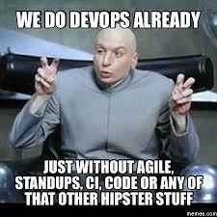
Continuous Integration Why
Improve Quality
Reduce Risk
Feedback team integration
Feedback on quality of code
Enables the flow from commit to deploy

Slide 48
Continuous Integration
Failure should be expected and embraced.
Fail fast and fail early.
If you fail while developing, then it’s cheap to fix
If you fail in production, then a fix becomes much more expensive
Teams should rally around resolving failures.
Retrospect regularly.
“Inspect & Adapt” to change processes that aren’t working

Slide 49
Continuous Integration What
In software engineering, continuous integration (CI) is the practice of merging all developer working copies to a shared mainline several times a day. Extreme programming (XP) adopted the concept of CI and did advocate integrating more than once per day - perhaps as many as tens of times per day. Each check-in is then verified by an automated build, allowing teams to detect problems early. Many teams find that this approach leads to significantly reduced integration problems and allows a team to develop cohesive software more rapidly.
Practics:
Collective Code Ownership – GIT/SVN
Automated Build - Maven
Behavior Driven Development – Gherkin/Cucumber
Test Driven Development - Junit
Refactoring - Eclipse
Static Code Analysis – SonarQube
Continuous Integration - Jenkins

Slide 50
Continuous Integration How Hand on Lab – Jenkins commit job
Setup
Log into Jenkins Server
Select “Devops 4 Teams View” From views
Select New Item
See the documentation in the mvn site

Slide 51
Continuous Integration Next
What do you choose to do with this knowledge and experience?
Will you or your team implement next week/iterations?
Who will you teach it to?
Attend a meetup?
Post what you know on your blog?
References:
Continuous Integration blog by Martian Fowler
Continuous Integration Book by Paul Duvall
Book site
Jenkins Tutorial
Jenkins video

Slide 52
Automated Acceptance Testing

Slide 53
Automated Acceptance Testing
Value Statement:
As a student
I want to understand
and be able to automate acceptance tests
So that I can know what the status of software development is
and communicate with product owner, customers and other stake holder
Acceptance Criteria (Gherkin):
Given an acceptance criteria
When documented in gherkin
Then the status of software development is clear to all state holders
Given an acceptance criteria
When documented in gherkin
Then the status of software development is clear to all state holders

Slide 54
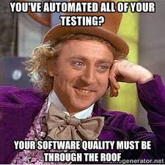
Automated Acceptance Testing Why
Providing a shared process and shared tools promoting communication to the software developers, business analysts and stakeholders to collaborate on software development, with the aim of delivering product with business value.
What a system should do and not on how it should be implemented.
Providing better readability and visibility.
Verifying not only the working of the software but also that it meets the customer’s expectations.
Provides a suite of test used as a regressions test suite

Slide 55
Automated Acceptance Testing What
Behavior-driven development combines the general techniques and principles of TDD with ideas from domain-driven design and object-oriented analysis and design to provide software development and management teams with shared tools and a shared process to collaborate on software development.
Although BDD is principally an idea about how software development should be managed by both business interests and technical insight, the practice of BDD does assume the use of specialized software tools to support the development process. Although these tools are often developed specifically for use in BDD projects, they can be seen as specialized forms of the tooling that supports test-driven development.
- Wikipedia

Slide 56
Automated Acceptance Testing
Regression testing becomes critical as an application evolves.
As an application grows in complexity, regression testing will begin to take up more time.
Automated testing should be considered from the beginning of the development process.
Developers should design and code keeping automation testing in mind even while building a feature
Consider avoiding third party tools that require manual configuration or setup for every change. For effective automation, a team should use tools that they can program against.

Slide 57
Automated Acceptance Testing
As with all DevOps processes, fixing failing tests is the joint responsibility of the application development team.
Pay attention to the pipeline!
A team’s goal should be to always have a “Green” build-test pipeline on their CI system.
If the pipeline turns amber or red, a team should immediately work together to resolve the issue.
Failing tests are not just a problem for the developer who performed the latest commit; it is the problem of the entire team. A broken pipeline keeps the entire team from delivering any piece of code to production. The focus should always be to fix the pipeline first, not to assign blame or point fingers.

Slide 58
Automated Acceptance Testing - cucumber How

Slide 59
Automated Acceptance Testing Next
What do you choose to do with this knowledge and experience?
Will you or your team implement next week/iterations?
Who will you teach it to?
Attend a meetup?
Post what you know on your blog?
References:
The Cucumber Book - Book
Behavior Driven Development - Fannie Mae Course
Behavior Driven Development – Tutorial
Cucumber - tutorial
Junit Cucumber Tutorial – video

Slide 60
Unit Testing

Slide 61
Unit Testing
Value Statement:
As a student
I want to learn about test first unit testing
So that I can improve the quality of the software
Acceptance Criteria (Gherkin):
Given a unit of value required the application or service
When I start my work I write a unit test that specification of the value above
Then write the unit test of value specified by test
Given a feedback to refactor a unit of code
When our unit test fails
Then update my code to comply with the specification in the unit test

Slide 62
Unit Testing Why
Unit Tests allows you to make changes to code quickly.
TDD helps you to realize when to stop coding. The tests and the code work together to achieve better code.
TDD helps with coding constipation.
Unit Tests help you really understand the design of the code you are working on.
Unit Tests give you instant visual feedback, we all like the feeling of all those green lights when we've done. It's very satisfying.
Contrary to popular belief unit testing does not mean writing twice as much code, or coding slower
"Imperfect tests, run frequently, are much better than perfect tests that are never written at all”
Good unit tests can help document and define what something is supposed to do
Unit tests help with code re-use.
http://stackoverflow.com/questions/67299/is-unit-testing-worth-the-effort
Notes:
Your tests give you confidence that you've done enough for now and can stop tweaking and move on to the next thing.
. The tests and the code work together to achieve better code. Your code could be bad / buggy. Your TEST could be bad / buggy. In TDD you are banking on the chances of both being bad / buggy being low. Often it's the test that needs fixing but that's still a good outcome.
When faced with a large and daunting piece of work ahead writing the tests will get you moving quickly.
Instead of writing code to do something, you are starting by outlining all the conditions you are subjecting the code to and what outputs you'd expect from that.
It's also much easier to pick up where you left off after an interruption because you can see where you got to - that next red light that needs fixing.
. It's faster and more robust than coding without tests once you've got the hang of it. Test code itself is usually relatively trivial and doesn't add a big overhead to what you're doing. This is one you'll only believe when you're doing it :)
I interpret this as giving me permission to write tests where I think they'll be most useful even if the rest of my code coverage is woefully incomplete.
Migrate both your code and your tests to your new project. Tweak the code till the tests run again.

Slide 63
Unit Testing What
Unit testing simply verifies that individual units of code (mostly functions) work as expected. Usually you write the test cases yourself, but some can be automatically generated.
The output from a test can be as simple as a console output, to a "green light" in a GUI such as JUnit.
Performing unit tests is designed to be simple, generally the tests are written in the form of functions that will determine whether a returned value equals the value you were expecting when you wrote the function (or the value you will expect when you eventually write it - this is called Test Driven Development when you write the tests first).
http://stackoverflow.com/questions/652292/what-is-unit-testing-and-how-do-you-do-it

Slide 64
Unit Testing How
Test fast. Fail fast.
Tests should truly be unit.
Tests should run fast
Tests should involve a single piece of functionality (class-under-test)
Test code locally before every check-in or pull request.
Fix failures before every check-in or pull request
If everything passes, then continue forward
An automated testing job should be created that runs on each commit.
Untested code is incomplete code.

Slide 65
Unit Testing Mocking
Mocking is an efficient mechanism for testing a piece of code that integrates with external systems.
There are multiple tools and frameworks available to assist in creating “mocks”
Mocks should be based on an agreed specification between an application and the upstream or downstream system it is integrating with.
Tools:
Mockito – The Mockito framework for unit testing uses RPC calls, for example, that test the integration between different layers of an application (business-data access layer). The emphasis is on the behavior of the system and not the testing of protocols.
GreenHat – Other tools, such as GreenHat, can also be used to configure virtualized services that simulate upstream or downstream systems, for example, while running BDD tests.

Slide 66
Unit Testing - Junit How Hand on Lab
Please follow directions in the site documentation for this module.
Write unit tests to exercise a sample class
Execute unit tests locally to have them fail
Write a sample class to fill in logic to complete tests
Check-in code locally (commit the change)
Push local branch to remote
Any questions or issues? Let us know!

Slide 67
Unit Testing Next
What do you choose to do with this knowledge and experience?
Will you or your team implement next week/iterations?
Who will you teach it to?
Attend a meetup?
Post what you know on your blog?
References:
Test Driven Development class – Fannie Mae
Test-Driven Development by Ken Beck
Test Driven Development tutorial
Video

Slide 68
Static Analysis

Slide 69
Static Analysis
Value Statement:
As a student
I want to get feedback on my code
So that I can improve the quality of the software
Acceptance Criteria (Gherkin):
Given a code base
When we perform static analysis inspection
Then standards and best practices are followed
Given a code base
When we perform static analysis inspection
Then a build is failed/returned due to standards findings

Slide 70
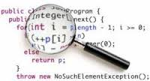
Static Analysis Why
Perpetuate development best practices
Create a collaborative learning experience
Feedback
Build in Quality

Slide 71
Static Analysis What
Static program analysis is the analysis of computer software that is performed without actually executing programs. In most cases the analysis is performed on some version of the source code, and in the other cases, some form of the object code.
The term is usually applied to the analysis performed by an automated tool, with human analysis being called program understanding, program comprehension, or code review. Software inspections and Software walkthroughs are also used in the latter case.
-Wikipedia

Slide 72


DevOps For Teams CQA Tooling in Context of Agile
SonarQube
Micro Work Increments: Issues identified during recurring in-sprint scans captured as tasks to a story or added to Release Backlog.
Sprint Planning: Final build scan identifies quality issues to be addressed as stories or tasks in the sprint\increment backlog.
Sprint/Increment
Work Cycle
✓
✓
✓
Release Backlog
Sprint\Increment
Backlog
Working Code
Project Planning:
Scan of production application (baseline)
provides input into product backlog by
Identifying existing structural quality issues.
Sprint\Increment Retrospective: End of sprint\increment final build scan provides insight into identifying repetitive programming issues for development process improvement.
End of Sprint\Increment Build: End of sprint\increment final build is scanned. Issues identified captured as stories or tasks in the release backlog for a future sprint\increment.

Slide 73
Static Analysis How Hands on Lab
Please follow the directions for the exercise.
Setting up for the lab
Navigate to SonarQube: http://dlsysadm-db03:9000/dashboard/index?did=10004
Create a code review based on your previous commit
Validation
Any questions or issues? Let us know!

Slide 74
Static Analysis Next
What do you choose to do with this knowledge and experience?
Will you or your team implement next week/iterations?
Who will you teach it to?
Attend a meetup?
Post what you know on your blog?
References:
Static Analysis
SonarQube – Tutorial
Beyound the Basics SonarQube - Video

Slide 75
Day 1 – Retrospective
Please provide your feedback on:
What did we do well, that if we don’t discuss we might forget?
What did we learn?
What should we do differently next time?
What still puzzles us?
Any other questions?

Slide 76
Day 1 – Q&A
Potential Topics:
Are there any Day 1 topics you would like to understand better?
Which Day 1 hands-on exercises were helpful?
Which Day 1 hands-on exercises were not helpful?
Any other questions?

Slide 77
DevOps Training Workshop – Day 2

Slide 78
Continuous Delivery Practices, Tools & Processes

Slide 79
Overview
Day 2 - Continuous Delivery
Process
Organization
Automated deployments – iCart
Data management
Smoke and Integration Testing
Day 3 - DevOps
Measurements
Improvements

Slide 80
Introduction to DevOps Fannie Mae’s DevOps Value Chain
DevOps Value Chain
“Transform technology at Fannie Mae for repeatable and scalable software development services that improve quality, reduce costs, and increase time to market”
AUTOMATED TRACEABILITY
iCart
Code
Requirements
Incidents/ Defects
CODE
QUALITY
CONTINUOUS
INTEGRATION/ DELIVERY
Automated Reporting
RELEASE MANAGEMENT
Design
Develop
Discover
Design
Discover
Discover
Test
Deploy
Monitor /
Operate
Test
Test
Design
Design
Sprint #1
Sprint #2
Test
Sprint #3
Develop
Develop
Develop
ENVIRONMENT
CONFIGURATION
TEST DATA DELIVERY
SERVICE VIRTUALIZATION
TEST AUTOMATION
AUTOMATED DATA VALIDATION
90% labor reduction for testing of large unit, component, integration, progression and regression suites
Early identification, tracking and remediation of code defects
Significantly faster provisioning of development & test environments
VM
Delphix
SeleniumHQ
Data Testing
Framework

Slide 81
Artifact Repositories

Slide 82
Artifact Repositories Value and Acceptance Criteria
Value Statement:
As a delivery team member
I want to store build packages
So that I can deploy them into environments
Acceptance Criteria (Gherkin):
Given a successful build
When I published the artifact to nexus
Then automated deploy scripts can access to install in the target environment
Given a successful build
When I published the artifact to nexus
Then other teams can access the artifact to use in their applications.

Slide 83
Artifact Repositories Why
Reliable and consistent access to remote artifacts
Build once deploy many
Reproducibility
Traceability
Hides the complexity of building the artifact
https://youtu.be/aa4YBDUDWy0
Notes:
The number one predictor of operations success is having versioned artifacts in an artifact repository
To have one spot where you have a known version of something that has been built and tested, and all the energy and effort has gone into making it – that is the value of the repository
A benefit of artifact repositories is a “central repository” that helps facilitate communication between #ops & #dev team

Slide 84
Artifact Repositories What
A library of reusable software components
A collection of binary software artifacts and metadata stored in a defined directory structure which is used by clients such Maven, Mercury, or Ivy to retrieve binaries during a build process.
Artifact have addresses - Group, Artifact, Version
For example: junit-4.11.jar is defined as a dependency in most projects object models(pom.xml) to support unit testing of java applications.
Notes:
Different then a source code repository
Compiled, binary

Slide 85
Artifact Repositories
An application artifact repository forms the backbone of a “build once and deploy everywhere” strategy.
Fannie Mae utilizes Nexus, which follows the Maven model.
Nexus supports the configuration of custom repositories that can track public repositories, like Maven Central.
Examples of other types of repositories
Snapshots – as the name suggests, this type of repository is used to store artifact versions from a specific point of time
Releases – Semantically, all production-ready artifacts should go here

Slide 86
Artifact Repository Strong Versioning
Versioning is an important element of a good configuration management strategy.
Semantic versioning:
Given a version number MAJOR.MINOR.PATCH.BUILD
Then increment the
MAJOR version when making incompatible API changes,
MINOR version when adding functionality in a backwards-compatible manner, and
PATCH/micro version when you make backwards-compatible bug fixes
qualifier — The qualifier is usually used to indicate a build identity, for example a time stamp. Different qualifiers do not signal any backward compatibility issues.

Slide 87
Artifact Repositories Dependency Management
Overview
A robust dependency management tool makes it easier to audit an application from a security standpoint while removing the overhead of hosting the dependencies.
Dependencies on external libraries should be explicitly specified.
Internal Fannie Mae libraries should use Nexus as an artifact repository with a well-defined versioning scheme (semantic versioning).
Maven as a Dependency Management Tool
Maven provides a declarative format for dependency management.
Maven deals more with “what” rather than “how/where” (Ex: Ant).

Slide 88
Artifact Repositories - Nexus How Hands on Lab
Please follow the directions for the exercise.
Setting up for the lab
Publish artifact to nexus
configure setting.xml to support publishing
validate permissions to publish
Mvn deploy
Enhance your Jenkins Commit job to publish your artifact to nexus
Visit developers expressway to check on clean downloads
Validation
Any questions or issues? Let us know!

Slide 89
Artifact Repositories Next
What do you choose to do with this knowledge and experience?
Will you or your team implement next week/iterations?
Who will you teach it to?
Attend a meetup?
Post what you know on your blog?
References:
http://blog.sonatype.com/2009/04/what-is-a-repository/
http://semver.org/

Slide 90
Database Migrations

Slide 91
Database Migrations
Value Statement:
As a student
I want to get feedback on my code
So that I can improve the quality of the software
Acceptance Criteria (Gherkin):
Given a ???
When I ???
Then ???

Slide 92
Database Migrations Why
Define state of a database
State of migration script execution
Set up a new database instance

Slide 93
Database Migrations What
A tool that keeps migration scripts and the database in sync

Slide 94
Database Migration
Database migration can help to regain control of databases across environments.
Many projects still rely on manually applied SQL scripts.
As a result many questions often arise:
What state is the database on this machine?
Has the script already been applied or not?
Has a “quick fix” in production been applied to lower environments?
How can a team set up a new database instance?
Database migrations are a great way to control this.
They allow a team to:
Recreate a database from scratch
Make the state of the database clear at all times
Migrate in a deterministic way from a current version of the database to a newer version.

Slide 95
Database Migrations - Flyway How Hands on Lab
Please follow the directions for the exercise.
Setting up for the lab
Navigate to SonarQube: http://dlsysadm-db03:9000/dashboard/index?did=10004
Create a code review based on your previous commit
Validation
Any questions or issues? Let us know!

Slide 96
Database Migrations Next
What do you choose to do with this knowledge and experience?
Will you or your team implement next week/iterations?
Who will you teach it to?
Attend a meetup?
Post what you know on your blog?
References:
https://flywaydb.org/
Flyway – tutorial
Flyway: The agile database migration framework for Java - video

Slide 97
Automated Deployments

Slide 98
Automated Deployments
Value Statement:
As a delivery team member
I want to automatically deploy applications
So that I can improve the quality of the software
Acceptance Criteria (Gherkin):
Given a ???
When I ???
Then ???
Given a ???
When I ???
Then ???

Slide 99
Automated Deployments Why
Deployments become much less error-prone and much more repeatable
Anyone in the team can deploy software
Engineers spend their time developing software
Deploying to somewhere new is not a headache
You can release more frequently

Slide 100
Automated Deployments What

Slide 101
Automated Deployments – iCART
iCART is the primary deployment tool used at Fannie Mae.
Utilizes a push model for deployment
Has the capability to build and publish artifacts to Nexus/SVN (non-Maven projects)
Can pull artifacts from Nexus and deploy to any target environment
The Jenkins-iCART bridge allows triggering of iCART deployments from within a Jenkins pipeline.

Slide 102
Automated Deployments – iCART Hands-On Lab
Please follow the directions for the exercise found in you project site.
Navigate to Jenkins
Create a deploy job
Create a copy of the existing deployment job
Change the values based on the branch
Review the script invocation with instructor
Test the deployment
Any questions or issues? Let us know!

Slide 103
Automated Deployments Next
What do you choose to do with this knowledge and experience?
Will you or your team implement next week/iterations?
Who will you teach it to?
Attend a meetup?
Post what you know on your blog?
References:

Slide 104
Continuous Documentation

Slide 105
Continuous Documentation
Value Statement:
As a student
I want to get feedback on my code
So that I can improve the quality of the software
Acceptance Criteria (Gherkin):
Given a ???
When I ???
Then ???

Slide 106
Continuous Documentation Why

Slide 107
Continuous Documentation
Documentation should not be an afterthought to development.
Documentation should happen concurrently with development.
Teams should strive to have all documentation in one centralized location rather than distributed across multiple systems.
Example documentation strategy:
Consider a Maven site as a documentation framework.
Configure a Maven site as another module in your project that gets built with every code commit.
Document all design decisions, architecture decisions, and API/schema definitions on the site. If done well, the documentation will be in sync with the code as the application evolves.
Document Governance requirements early

Slide 108
Continuous Documentation What

Slide 109
Continuous Documentation How Hands on Lab
Please follow the directions for the exercise.
Setting up for the lab
Navigate to SonarQube: http://dlsysadm-db03:9000/dashboard/index?did=10004
Create a code review based on your previous commit
Validation
Any questions or issues? Let us know!

Slide 110
Continuous Documentation Next
What do you choose to do with this knowledge and experience?
Will you or your team implement next week/iterations?
Who will you teach it to?
Attend a meetup?
Post what you know on your blog?
References:

Slide 111
Maven – Build Lifecycle
Build Lifecycle Phases
Validate - validate the project is correct and all necessary information is available
Compile - compile the source code of the project
Test - test the compiled source code using a suitable unit testing framework. These tests should not require the code be packaged or deployed
Package - take the compiled code and package it in its distributable format, such as a JAR.
Verify - run any checks on results of integration tests to ensure quality criteria are met
Install - install the package into the local repository, for use as a dependency in other projects locally
Deploy - done in the build environment, copies the final package to the remote repository for sharing with other developers and projects
https://maven.apache.org/guides/introduction/introduction-to-the-lifecycle.html

Slide 112
Maven – Directory layout
src/main/java | Application/Library sources
src/main/resources | Application/Library resources
src/main/resources-filtered | Application/Library resources which are filtered. (Starting with Maven 3.4.0, not yet released.)
src/main/filters | Resource filter files
src/main/webapp | Web application sources
src/test/java | Test sources
src/test/resources | Test resources
src/test/resources-filtered | Test resources which are filtered by default. (Starting with Maven 3.4.0, not yet released.)
src/test/filters | Test resource filter files
src/it | Integration Tests (primarily for plugins)
src/assembly | Assembly descriptors
src/site | Site
LICENSE.txt | Project's license
NOTICE.txt | Notices and attributions required by libraries that the project depends on
README.txt | Project's readme https://maven.apache.org/guides/introduction/introduction-to-the-standard-directory-layout.html

Slide 113
Maven – Project Object Model (POM)

Slide 114
Feature Isolation
Feature branches and feature flags are some of the mechanisms that can be used to avoid pushing half-baked features into production.
Feature flags
Application-level solution
May not scale when a lot of features are being developed or waiting to be developed
Feature branches
Effective strategy when a lot of development is happening concurrently
Emphasis should continue to be on integrating frequently with the main branch (trunk)
A pipeline should be considered for each of the feature branches

Slide 115
Discussion Application Readiness Survey Testing
The instructor’s will ask questions based on a review of the survey results.
Bonus hands-on exercise:
Create a high-level backlog of DevOps stories/tasks/requirements.
List known dependencies from external teams.
Define a realistic high-level schedule to complete those tasks.
Testing

Slide 116
Hands-On Exercise Configure an integrated testing and deployment framework
Please follow the instructor’s directions for the exercise.
Create a Jenkins job to automate a build.
Create a Jenkins job to automate deployment to a DEV environment.
Create a Jenkins job to report on quality control (JUnit, Cucumber, etc.).
Create a Jenkins job to automate a DB deployment.
Create a Jenkins job to build a Maven site.
Any questions or issues? Let us know!

Slide 117
Hands-On Exercise Configure an integrated testing and deployment framework
Please follow the instructor’s directions for the exercise.
Create a delivery pipeline.
https://wiki.jenkins-ci.org/display/JENKINS/Delivery+Pipeline+Plugin
Any questions or issues? Let us know!

Slide 118
Day 2 – Retrospective
Please provide your feedback on:
What did we do well, that if we don’t discuss we might forget?
What did we learn?
What should we do differently next time?
What still puzzles us?
Any other questions?

Slide 119
Day 2 – Q&A
Potential Topics:
Are there any Day 2 topics you would like to understand better?
Which Day 2 hands-on exercises were helpful?
Which Day 2 hands-on exercises were not helpful?
Any other questions?

Slide 120
Capacity Testing

Slide 121
Capacity Testing
Value Statement:
As a student
I want to get feedback on my code
So that I can improve the quality of the software
Acceptance Criteria (Gherkin):
Given a ???
When I ???
Then ???

Slide 122
Capacity Testing Why

Slide 123
Capacity Testing What

Slide 124
Capacity Testing How Hands on Lab
Please follow the directions for the exercise.
Setting up for the lab
Navigate to SonarQube: http://dlsysadm-db03:9000/dashboard/index?did=10004
Create a code review based on your previous commit
Validation
Any questions or issues? Let us know!

Slide 125
Capacity Testing Next
What do you choose to do with this knowledge and experience?
Will you or your team implement next week/iterations?
Who will you teach it to?
Attend a meetup?
Post what you know on your blog?
References:

Slide 126
Security

Slide 127
Security
Value Statement:
As a student
I want to get feedback on my code
So that I can improve the quality of the software
Acceptance Criteria (Gherkin):
Given a ???
When I ???
Then ???

Slide 128
Security Why

Slide 129
Security What

Slide 130
Security How Hands on Lab
Please follow the directions for the exercise.
Setting up for the lab
Navigate to SonarQube: http://dlsysadm-db03:9000/dashboard/index?did=10004
Create a code review based on your previous commit
Validation
Any questions or issues? Let us know!

Slide 131
Security Next
What do you choose to do with this knowledge and experience?
Will you or your team implement next week/iterations?
Who will you teach it to?
Attend a meetup?
Post what you know on your blog?
References:

Slide 132
Overview
Day 3 - DevOps
Measurements
QREP
RapidIT
Service Virtualization

Slide 133
Measurement
http://ganglia.info/
https://ganglia.wikimedia.org/latest/

Slide 134
Day 3 – Retrospective
Please provide your feedback on:
What topics would you like to discuss MORE?
What topics would you like to discuss LESS?
Any other questions?

Slide 135
Monitoring and Measurements

Slide 136
Monitoring and Measurements
Value Statement:
As a student
I want to get feedback on my code
So that I can improve the quality of the software
Acceptance Criteria (Gherkin):
Given a ???
When I ???
Then ???

Slide 137
Monitoring and Measurements Why

Slide 138
Monitoring and Measurements What

Slide 139
Automated Deployments How Hands on Lab
Please follow the directions for the exercise.
Setting up for the lab
Navigate to SonarQube: http://dlsysadm-db03:9000/dashboard/index?did=10004
Create a code review based on your previous commit
Validation
Any questions or issues? Let us know!

Slide 140
Automated Deployments Next
What do you choose to do with this knowledge and experience?
Will you or your team implement next week/iterations?
Who will you teach it to?
Attend a meetup?
Post what you know on your blog?
References:

Slide 141
Governance

Slide 142
Governance
Value Statement:
As a student
I want to get feedback on my code
So that I can improve the quality of the software
Acceptance Criteria (Gherkin):
Given a ???
When I ???
Then ???

Slide 143
Governance Why

Slide 144
Governance What

Slide 145
Governance How Hands on Lab
Please follow the directions for the exercise.
Setting up for the lab
Navigate to SonarQube: http://dlsysadm-db03:9000/dashboard/index?did=10004
Create a code review based on your previous commit
Validation
Any questions or issues? Let us know!

Slide 146
Governance Next
What do you choose to do with this knowledge and experience?
Will you or your team implement next week/iterations?
Who will you teach it to?
Attend a meetup?
Post what you know on your blog?
References:

Slide 147
Infrastructure as Code

Slide 148
Infrastructure as Code
Value Statement:
As a student
I want to get feedback on my code
So that I can improve the quality of the software
Acceptance Criteria (Gherkin):
Given a ???
When I ???
Then ???

Slide 149
Infrastructure as Code Why

Slide 150
Infrastructure as Code What

Slide 151
Infrastructure as Code How Hands on Lab
Please follow the directions for the exercise.
Setting up for the lab
Navigate to SonarQube: http://dlsysadm-db03:9000/dashboard/index?did=10004
Create a code review based on your previous commit
Validation
Any questions or issues? Let us know!

Slide 152
Infrastructure as Code Next
What do you choose to do with this knowledge and experience?
Will you or your team implement next week/iterations?
Who will you teach it to?
Attend a meetup?
Post what you know on your blog?
References:
RapidIT - Video

Slide 153
Day 3 – Retrospective
Please provide your feedback on:
What did we do well, that if we don’t discuss we might forget?
What did we learn?
What should we do differently next time?
What still puzzles us?
Any other questions?

Slide 154
Day 3 – Q&A
Potential Topics:
Are there any Day 2 topics you would like to understand better?
Which Day 2 hands-on exercises were helpful?
Which Day 2 hands-on exercises were not helpful?
Any other questions?

Slide 155

Every Thursday from noon to 1:00 p.m.
In person: DC 4000, RDC, RCD and Herndon OB1 Cafeterias
Webex: Topic Specific Training and Q&A
This is your opportunity to get answers to your questions about:
Agile definitions, practices, process, etc.
Kanban/Scrum
Agile Tools
Agile Training
Agile Testing
DevOps
For more info on Agile visit:
http://sharepoint/sites/DevelopmentServices/Agile/Pages/Home.aspx

